Slide 1
GEOG-G489/589 Python Programming
Instructor: Natasha MacBean
If statements and brief overview of for loops

Slide 2
First, brief refresher on for loops
Syntax:
for var in sequence:
expression
List or array that you can iterate over
Can be list/array of strings, in which case var would return each string in the list/array sequence.
Can be a list/array of numbers that we can use to index another list or array.
If you have a list/array of strings but you also want to know their index, use enumerate.
This “expression” can be one or many lines of code that we use to carry out functions within the for loop

Slide 3
First, brief refresher on for loops
If you want to save something outside the loop, you need to set up the variable that you will save the information to outside the loop…
You can either have a blank list/array that you can append to, or you can create an array of zeros with the size of the array corresponding to the amount of information you will output.
list_name = [ ]
list_name.append(new_info)
array_name = np.array([ ])
array_name = np.append( array_name, new_info )
array_name = np.zeros( size of info that you will need )
Within loop: array_name[var] = new_info

Slide 4
If statements
Conditions result in either True or False (can also be 1 or 0)
If true or 1, the statement will be executed. If False or 0, nothing will happen.
Syntax:
if condition:
statement
if condition:
statement
else:
statement
if condition:
statement
elif another_condition:
statement
else:
statement
As with for loops, you must indent the statement inside the if block
Example where you have the alternative case to if condition
Example where you have several conditions you want to test

Slide 5
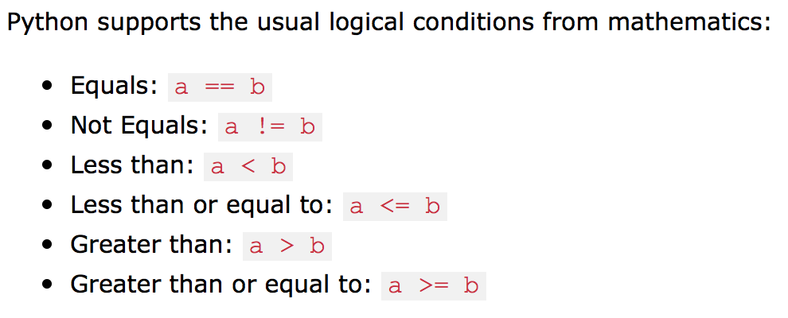
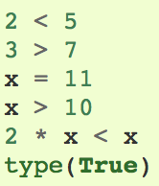
Example conditions
Notes:
https://www.w3schools.com/python/python_conditions.asp

Slide 6
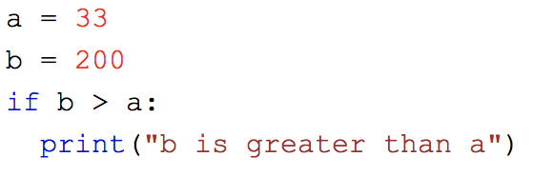
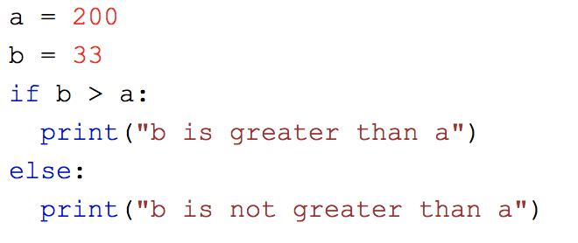
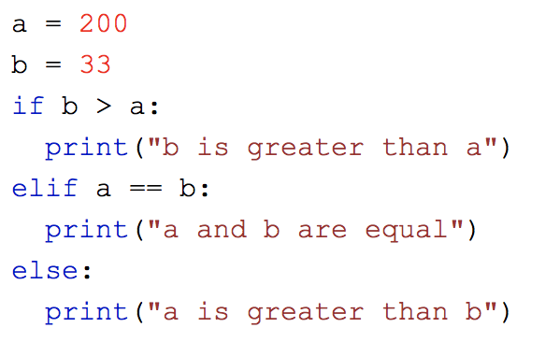
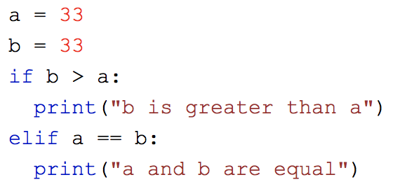
Example if statements
Notes:
https://www.w3schools.com/python/python_conditions.asp

Slide 7
Shorthand

Slide 8
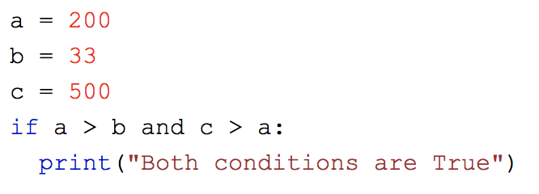
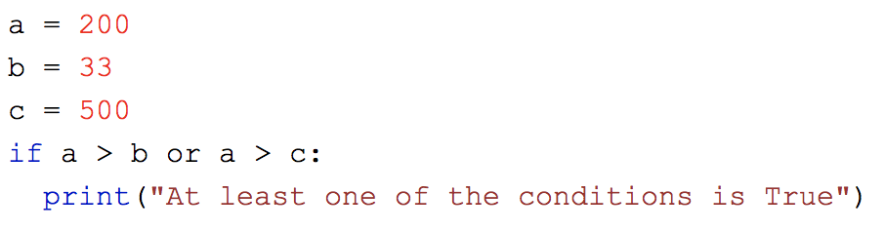
And… Or…

Slide 9
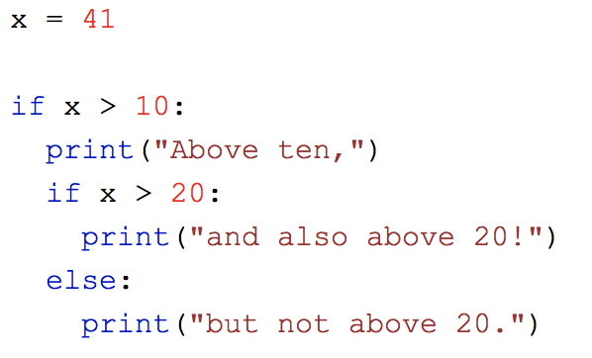
Nested for and if loops are both possible – just increase the indentation each time.

Slide 10
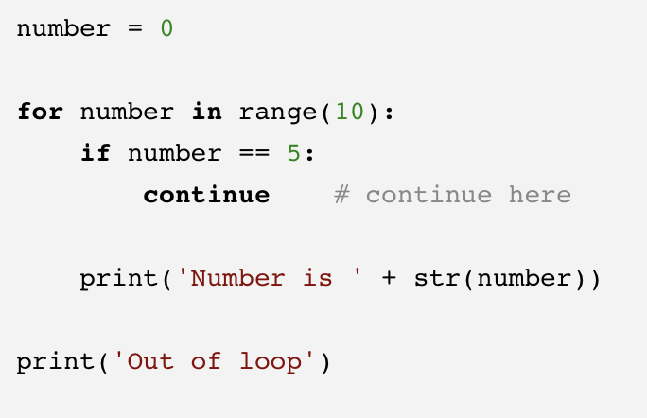
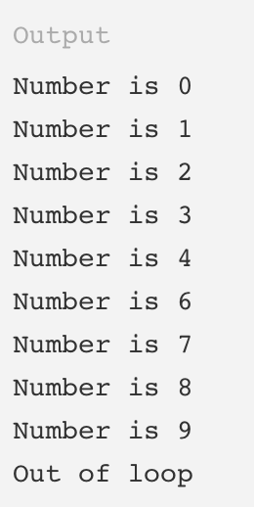
Continue → continues with next iteration of the loop

Slide 11
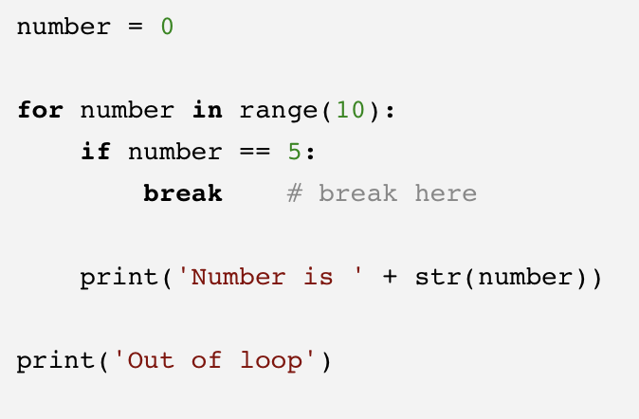
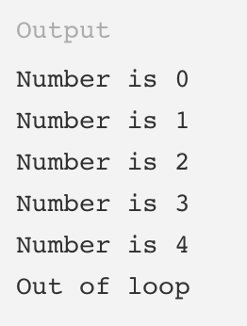
Break → breaks completely out of the loop

